Slide 1
Pune Vidyarthi Griha’s College of Engineering & Technology &G. K. Pate (Wani) Institute of Management, Pune DEPARTMENT OF ELECTRONICS AND TELECOMMUNICATION ENGINEERING Academic Year: 2023-2024
A Geo-Intelligent Crop Advisor and Market Predictor System for Farmers
Name of Project Group members
1. Anushray Nitin Pingale
2. Aditya Vilas Chavan
3. Tejas Gopal Kulkarni
4. Darshan Vijay Pakhale
Name of Guide: Prof. Anand S. Najan

Slide 2
Pune Vidyarthi Griha’s College of Engineering & Technology &G. K. Pate (Wani) Institute of Management, Pune DEPARTMENT OF ELECTRONICS AND TELECOMMUNICATION ENGINEERING Academic Year: 2023-2024
Objectives of the project:
To classify soil images into different categories.
To implement different models and find the best suitable model for soil image classification.
To suggest crops according to regions.
To suggest the best suitable market.

Slide 3
Pune Vidyarthi Griha’s College of Engineering & Technology &G. K. Pate (Wani) Institute of Management, Pune DEPARTMENT OF ELECTRONICS AND TELECOMMUNICATION ENGINEERING Academic Year : 2023-2024
Expected Outcomes:
To create a AI,ML prediction system which
helps identify soil type.
Problem Definition:
To recommend the crops,ph, rainfall, industry using machine learning and deep learning based on soil image, n,p,k and region.

Slide 4
Pune Vidyarthi Griha’s College of Engineering & Technology &G. K. Pate (Wani) Institute of Management, Pune DEPARTMENT OF ELECTRONICS AND TELECOMMUNICATION ENGINEERING Academic Year: : 2023-2024
Literature Survey/Market Survey:
Sr. No. | Author | Year | Title | Description
1 | S.R.Rajeswari , Parth Khunteta, et al. | 2019 | “Smart Farming Prediction Using Machine Learning” | These paper mainly focus on the algorithms such as SVM used to predict crop yield ,crop cost prediction.
2 | John Carlo V. Puno1 et al. | 2020 | “Soil Nutrient Detection using Genetic Algorithm” | In this paper Genetic Algorithm is the method used in this study in classifying the qualitative level of the soil nutrients. The extracted features were the HSV values and the LAB values color space.

Slide 5
Pune Vidyarthi Griha’s College of Engineering & Technology &G. K. Pate (Wani) Institute of Management, Pune DEPARTMENT OF ELECTRONICS AND TELECOMMUNICATION ENGINEERING Academic Year: : 2023-2024
Literature Survey/Market Survey:
Sr. No. | Author | Year | Title | Description
3 | Sonal Jain et al. | 2022 | “Machine Learning convergence for weather based crop selection” | Machine learning algorithms such as Recurrent neural network is used for weather prediction, and Random forest classification algorithm is used to select suitable crops.

Slide 6
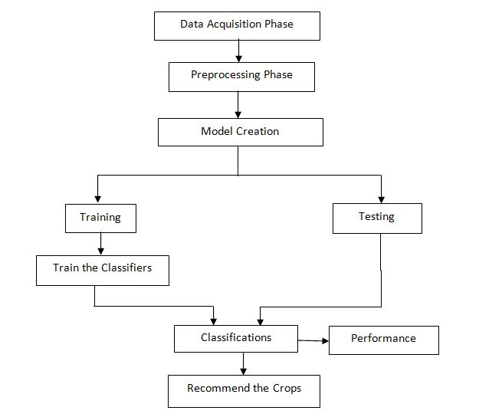
Pune Vidyarthi Griha’s College of Engineering & Technology &G. K. Pate (Wani) Institute of Management, Pune DEPARTMENT OF ELECTRONICS AND TELECOMMUNICATION ENGINEERING Academic Year: 2023-2024
Block Diagram:

Slide 7
Pune Vidyarthi Griha’s College of Engineering & Technology &G. K. Pate (Wani) Institute of Management, Pune DEPARTMENT OF ELECTRONICS AND TELECOMMUNICATION ENGINEERING Academic Year: 2023-2024
Specifications:
We are going to give input in terms of images, N,P, K and region.
Based on these inputs we intend to provide crops, ph, rainfall, industry.

Slide 8
Pune Vidyarthi Griha’s College of Engineering & Technology &G. K. Pate (Wani) Institute of Management, Pune DEPARTMENT OF ELECTRONICS AND TELECOMMUNICATION ENGINEERING Academic Year: 2023-2024
List of hardware and software simulation tools:
SOFTWARE REQUIREMENTS:-
Operating System - Windows 10
Front End - CSS, HTML
Back End - Python
Database - SQlite3
IDE - Spyder and Pycharm
HARDWARE REQUIREMENTS:-
Processor - 13
Speed - 1.1 GHz
RAM - 2 GB(min)
Hard Disk - 20 GB
Key Board - Standard Windows Keyboard
Mouse - Two or Three Button Mouse

Slide 9
Pune Vidyarthi Griha’s College of Engineering & Technology &G. K. Pate (Wani) Institute of Management, Pune DEPARTMENT OF ELECTRONICS AND TELECOMMUNICATION ENGINEERING Academic Year: 2023-2024
Work done and results:
The step-by description of the procedure of proposed system is as follows:
Dataset Gathering
Preprocessing of data
Model Creation
Obtain the useful images to classify the soil type

Slide 10
Pune Vidyarthi Griha’s College of Engineering & Technology &G. K. Pate (Wani) Institute of Management, Pune DEPARTMENT OF ELECTRONICS AND TELECOMMUNICATION ENGINEERING Academic Year: 2023-2024
Work done and results:
A] Dataset Gathering:
Every Machine Learning model works on the data.
The dataset gathering is first step of any machine learning or deep learning
project.
We have collected the dataset of diseases from kaggle platform.
We have split the data into two parts:

Slide 11
Pune Vidyarthi Griha’s College of Engineering & Technology &G. K. Pate (Wani) Institute of Management, Pune DEPARTMENT OF ELECTRONICS AND TELECOMMUNICATION ENGINEERING Academic Year: 2023-2024
Work done and results:
1] Training
The training folder contains 651 images. Basically the models will
learn the features from training data.
2] Testing
The testing folder contains 131 images. This test data will check the
performance of Model on trained data.

Slide 12
Pune Vidyarthi Griha’s College of Engineering & Technology &G. K. Pate (Wani) Institute of Management, Pune DEPARTMENT OF ELECTRONICS AND TELECOMMUNICATION ENGINEERING Academic Year: 2023-2024
Work done and results:
B] Dataset Pre-Processing:
The dataset contains different sizes of every image.
In that we are converted the every image into standard size.
i.e.(224*224).
C] Data Augmentation:
In this step we are performing some transformations on images such as rotate the
Image into 40 degree/angle, zoom the image with 0.2 scale factor and changing
The Contrast of original image.

Slide 13
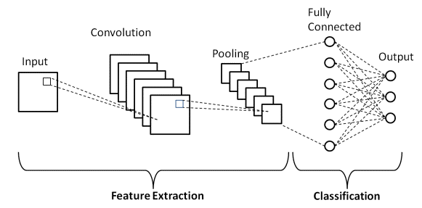
Algorithms:
CNN
CNN takes in processed images as input.
Extracts different features about the images regardless of their position using a series of mathematical operations to identify the pattern. Every layer in CNN has API which transforms input to output with differentiable functions.
In this project we are detecting soil type from images by CNN model.
Generally the CNN model provides good accuracy on images classification.

Slide 14
2. Random Forest:
Random forest is a Supervised Machine Learning Algorithm that is used widely in Classification and Regression problems. It reduces the overfitting problems.
It builds decision trees on different samples and takes their majority vote for classification and average in case of regression.

Slide 15
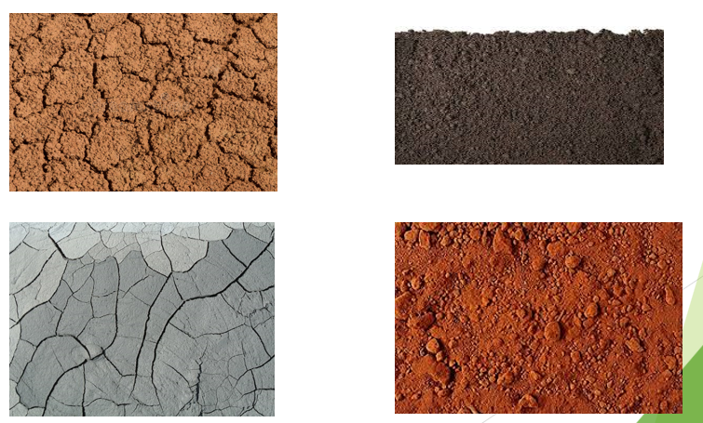
Pune Vidyarthi Griha’s College of Engineering & Technology &G. K. Pate (Wani) Institute of Management, Pune DEPARTMENT OF ELECTRONICS AND TELECOMMUNICATION ENGINEERING Academic Year: 2023-2024
Work done and results:
Dataset Images

Slide 16
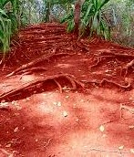
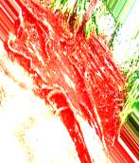
Pune Vidyarthi Griha’s College of Engineering & Technology &G. K. Pate (Wani) Institute of Management, Pune DEPARTMENT OF ELECTRONICS AND TELECOMMUNICATION ENGINEERING Academic Year: 2023-2024
Work done and results:
Resized Image
Rotated Image

Slide 17
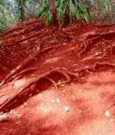
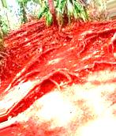
Pune Vidyarthi Griha’s College of Engineering & Technology &G. K. Pate (Wani) Institute of Management, Pune DEPARTMENT OF ELECTRONICS AND TELECOMMUNICATION ENGINEERING Academic Year: 2023-2024
Work done and results:
Zoom Image
Brighter Image

Slide 18
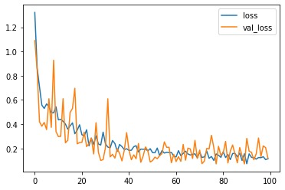
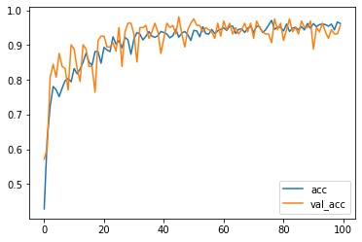
Pune Vidyarthi Griha’s College of Engineering & Technology &G. K. Pate (Wani) Institute of Management, Pune DEPARTMENT OF ELECTRONICS AND TELECOMMUNICATION ENGINEERING Academic Year: 2023-2024
Work done and Result:
Loss vs Epoche
Accuracy vs Epoche

Slide 19
Pune Vidyarthi Griha’s College of Engineering & Technology &G. K. Pate (Wani) Institute of Management, Pune DEPARTMENT OF ELECTRONICS AND TELECOMMUNICATION ENGINEERING Academic Year: 2023-2024
References:
[1] S.R.Rajeswari , Parth Khunteta, Subham Kumar,Amrit Raj Singh,Vaibhav Pandey “Smart Farming Prediction Using Machine Learning” International Journal of Innovative Technology and Exploring Engineering (IJITEE).
[2] John Carlo V. Puno1 , Rhen Anjerome R. Bedruz1 , Allysa Kate M. Brillantes “Soil Nutrient Detection using Genetic Algorithm” Manufacturing Engineering and Management Department IEEE.
[3] R. Reshma, V. Sathiyavathi and T. Sindhu et al. “IoT based Classification Techniques for Soil Content Analysis and Crop Yield Prediction” Proceedings of the Fourth International Conference on I-SMAC (IoT in Social, Mobile, Analytics and Cloud) (I-SMAC).
[4] Sonal Jain, Dharavath Ramesh, “Machine Learning convergence for weather based crop selection” 2020 IEEE International Students’ Conference on Electrical, Electronics and Computer Science.
[5] Pallavi Srivastava, Atul Bansal, Asheesh Shukla “A Comprehensive review on soil classification using deep learning and computer vision techniques ” 2021 dept E&TC, GLA university Mathura (India) Springer.

